Slide 1
Global E-commerce Sales Analysis Report
(2023-2025)
Power BI Dashboard Project
Name: Jayshri Chaudhari

Slide 2
Dataset Overview
Source: Kaggle
Data: Orders, Sales, Profit, Discount, Shipping
Time Period: 2023-2025
Total Orders: 2K

Slide 3
Problem Statement
Understand sales and performance
Identify loss-making areas
Analyze impact of discount
Find growth opportunities

Slide 4
Tools & Approach
Data cleaning using Power Query
Data modeling in Power BI
Created KPIs: Sales
Profit
Orders
Profit Margin
Build interactive dashboard with filters

Slide 5
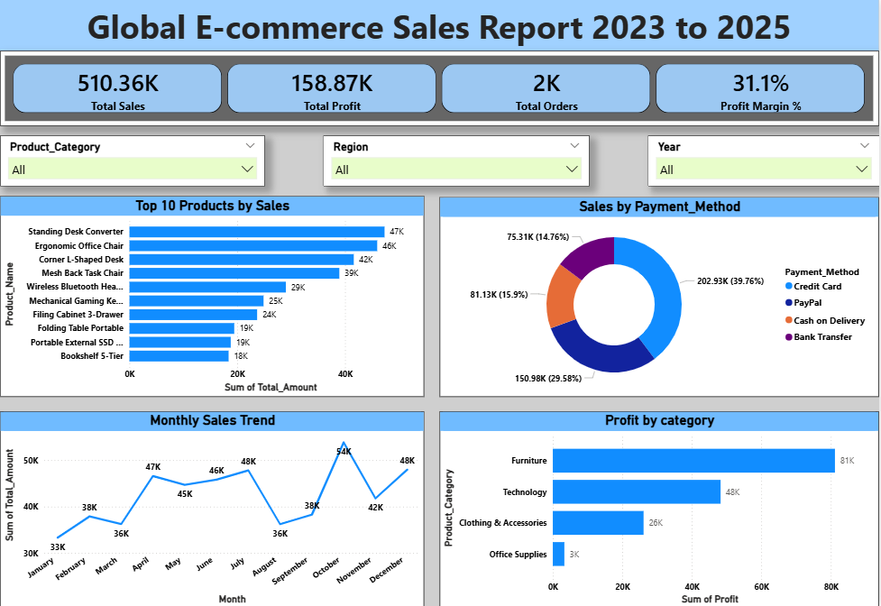
Dashboard Overview
* KPIs Overview * Slicer * Top Products
* Sales trend * Payment Methods

Slide 6
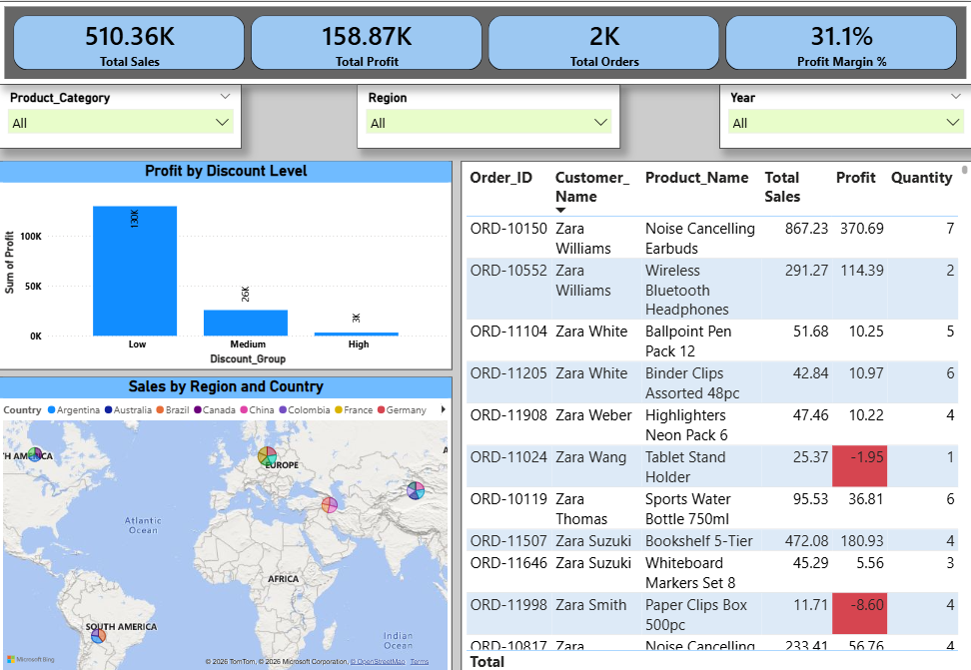
Detailed Analysis
* Discount vs. Profit * Regional sales distribution
* Order-level insights

Slide 7
Key Insights
Low discount → High Profit
High discount → Profit drops
Furniture = Highest profit category
Sales peak in Oct-Dec
Some Orders show negative profit

Slide 8
Recommendations
Maximize profit, Not Just Sales
* Control high discounts
* Reduce shipping cost impact
* Focus on high-profit categories
* Target peak months
* Improve/remove low-profit products

Slide 9
Conclusion
Profit depends on cost control, not just sales
Discounts and shipping must be balanced
Data helps in better decision-making

Slide 10
Thank You
Questions?

